Slide 1
Functions&Class

Slide 2

FUNCTIONS

Slide 3

FUNCTIONS
A function, sometimes refereed to as a subroutine, procedure or method, depending on the specifics of where or how it is used, is a sequence of code that performs a specific task.
This code is collected together and given a name, so that it can be easily called on anytime that specific task needs to be performed.
Function指可以完成／实现某特定任务的一串代码，通常这些代码被集成封装并被赋予特定的名字，以便随时在需要的场合被调用

Slide 4

PREDEFINED & USER-DEFINED FUNCTIONS
Some functions are predefined within the language, for example in Processing there are the setup(), draw(), ellipse() and rect() functions, as well as many others.
However, functions can also be defined by programmers such as yourself.
自定义function：除了程序自带的function之外，用户可以自定义function

Slide 5

REUSABILITY & MODULARITY
Functions make your code more reusable and modular.You should create a function whenever there is a task that you would like to perform repeatedly, or whenever you find yourself repeating the same sequence of code. By creating functions you will save yourself from having to repeat all of the individual statements over and over again throughout your program.
当你发现你需要在你的程序里面重复使用某段代码的时候／重复执行某项任务时，你需要定义function，这样不仅节省时间也使程序结构清晰易读

Slide 6

FUNCTION DECLARATION｜定义
User-defined functions must be declared before they can be used.
This process involves defining the
characteristics of the function, including it’s name, any required values, as well as the specific task it will perform.
用户自定义的function必须先定义再使用，其中包括function名，输入变量，以及完成指定任务的代码

Slide 7

FUNCTION NAMES
Function naming conventions follow the same rules as variable naming, and are often a matter of preference.
Function names should clearly convey the purpose of the function while being as short as possible.
Use underscores or camel-case to join multiple words together.
Function名遵循变量名同样的命名规则／习惯，单驼峰，简明清晰易读

Slide 8

FUNCTION ARGUMENTS (PARAMETERS)
Functions sometimes require on a value or values to perform their task.
For example, rect() needs to know the x and y coordinates as well as the height and width of the rectangle to draw.
These values are included within parentheses and separated by commas. These values pass into the function where they become local variables.
很多情况下function要求输入参量，比如 rect（）要求输入x，y坐标和长宽尺寸值，自定义function时候，这些参量将出现在function名后的括号中并以逗号隔开，function中这些变量可以被视作环境变量

Slide 9

FUNCTION TASK
The function’s task is set within open and closed curly braces, and typically contains multiple related statements.
Function中完成指定任务的代码在花括号中，通常是多行指令
PHOTO BY IANUS

Slide 10
USER-DEFINED FUNCTION EXAMPLE
void drawSomething(boolean a) {
if (a == true) {
ellipse(0, 0, 10, 10);
} else {
rect(0, 0, 10, 10);
}
}

Slide 11

有返回值的function FUNCTION RETURN TYPES
Functions sometimes return a value.
In Processing the return type, which
represents the type of value that will be returned, must be defined.
Return types match established variable types, such as boolean, int, char, etc.Use the word return inside the function to return a value.
很多function比如random（），map（）都是有返回值的，自定义有返回值的function需要指定返回值的变量类型，代码中以return 作为关键词返回结果变量

Slide 12
FUNCTION RETURN EXAMPLE
int addThisAndThat(int
a, int b) {
return a + b;
}
int c = addThisAndThat(1, 1);

Slide 13

VOID
Functions that do not return a value have a return type of void.
没有返回值的function用VOID关键词

Slide 14

CALLING FUNCTIONS
To call a function type it’s name followed by open and closed parentheses.
Include any arguments, if necessary, within the parenthesis.
You can also store the returned value in a variable.
调用function， function名加上括号和括号中的参量。对有返回值的function可以将其返回值直接赋值给指定变量。

Slide 15
CALLING FUNCTIONS EXAMPLE
drawSomething(false);
drawTarget(0, 0, 100, 5);
int x = addThisAndThat(4, 7);

Slide 16

OBJECTS

Slide 17
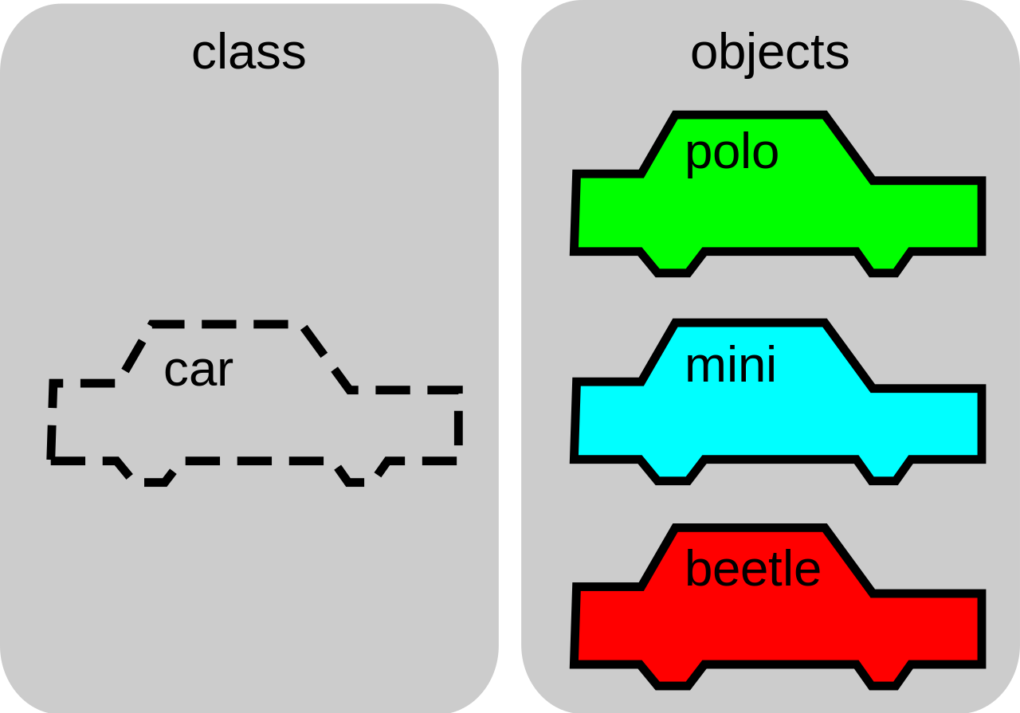
OBJECTS
Objects are complex customizable data structures within a program.
Like functions, they are aimed at creating modular, reusable code.
However, objects can contain multiple values and even multiple functions within a single structure.
Object和function的目标一样，目标是将代码模块儿化，重复使用，而object可以包含多个变量和多个function.

Slide 18
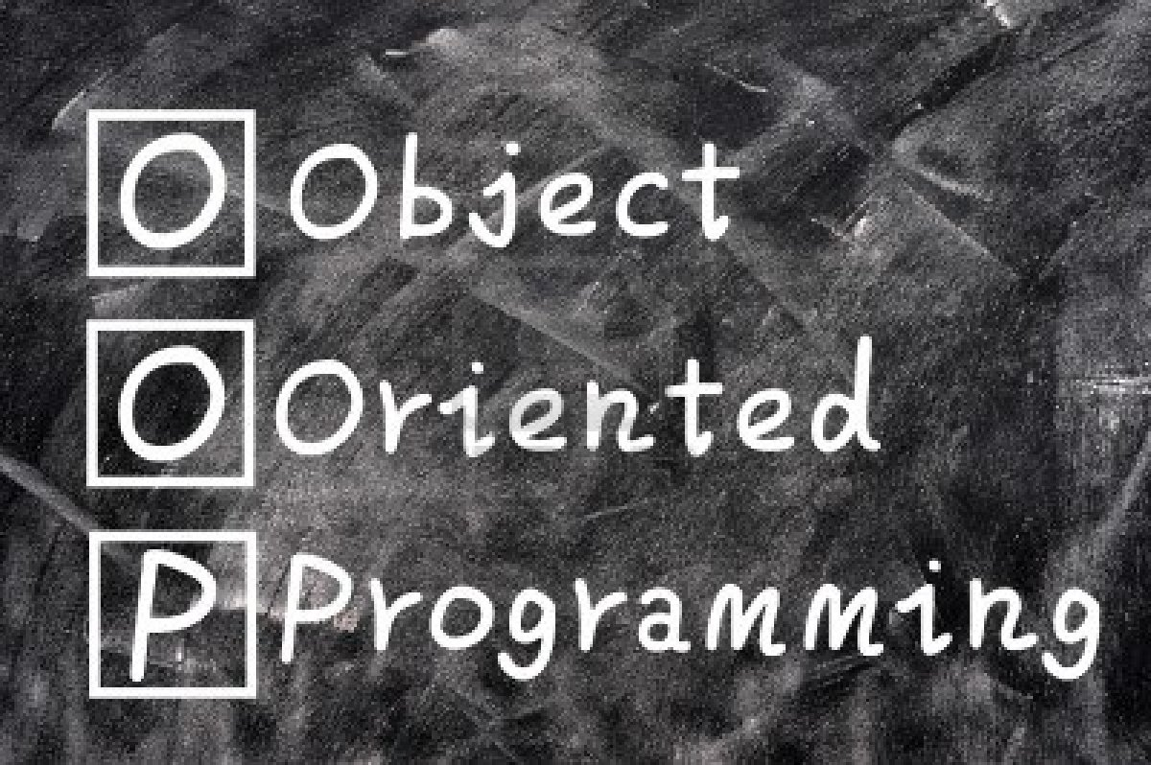
OBJECT ORIENTED PROGRAMMING｜面向对象编程
Over time, several approaches or methodologies have developed around the problems of programming, and using objects is one such approach.
Programming with objects is called Object Oriented Programming (OOP).
使用object的编程被称作：面向对象编程

Slide 19
CLASSES
In Processing and many other languages objects are instances of classes.
A class is a grouping of related data and subroutines.
Think of a class as a design or blueprint for something and the object as the instance or execution of that class.
A class is like a cookie cutter. Objects are the cookies made by a class.
在Processing和很多其他语言中，object是Class的instance
Instance：示例，个例，特例

Slide 20

FIELDS (VARIABLES & CONSTANTS)
A variable or constant that is defined within a class is called a field in processing and Java.
Some other languages refer to fields as properties.
Fields should be closely related to the class and its purpose within your program.
在class内部定义的Variable被称作field （processing／java中的名词），其他语言中也称之为properties，field只能和相应的class一起出现使用

Slide 21

VARIABLE SCOPE|作用域
Where you declare your variable in your program has an effect on where within the program that variable is available, this is referred to as scope.
变量的有效区间位置和变量声明的位置相关，这个区间／位置称之为作用域。

Slide 22

METHODS (FUNCTIONS)
A function that is defined within an object is called a method.
Methods should also be closely related to the object and its purpose within your program.
Class内定义的function称之为method，method只能和相应的class一起使用

Slide 23
CLASS DECLARATION EXAMPLE|示例
class Dog {
breed;
String color
dogColor;
Dog (String
b, color c) {
breed = b; dogColor= c;
}
void bark() { println("Woof!");
}
}

Slide 24
OBJECT INSTANTIATION & CONSTRUCTORS
To instantiate an object means to make a new copy of the object.
Classes contain a special method, called a constructor, which initializes the object when it is instantiated.
To create an instance of a class you use the new keyword as you call the constructor function.
新建一个instance即是创造class的一个新示例
Class内含一个封装的method－constructor， 用以新建instance，关键词为new

Slide 25
‘NEW’ KEYWORD
Constructors, like other functions, can accept parameters.
These parameters can be used to define unique qualities among a group of objects created using the same class.
To create an instance of a class you use the ‘new’ keyword as you call the constructor function
Dog spot = new Dog;
Constructor作为一个function，也需要parameter输入
NEW

Slide 26
OBJECT INSTANTIATION EXAMPLE｜示例
Dog spot = new
spot.bark();
Dog("Terrier",
color(0));

Slide 27
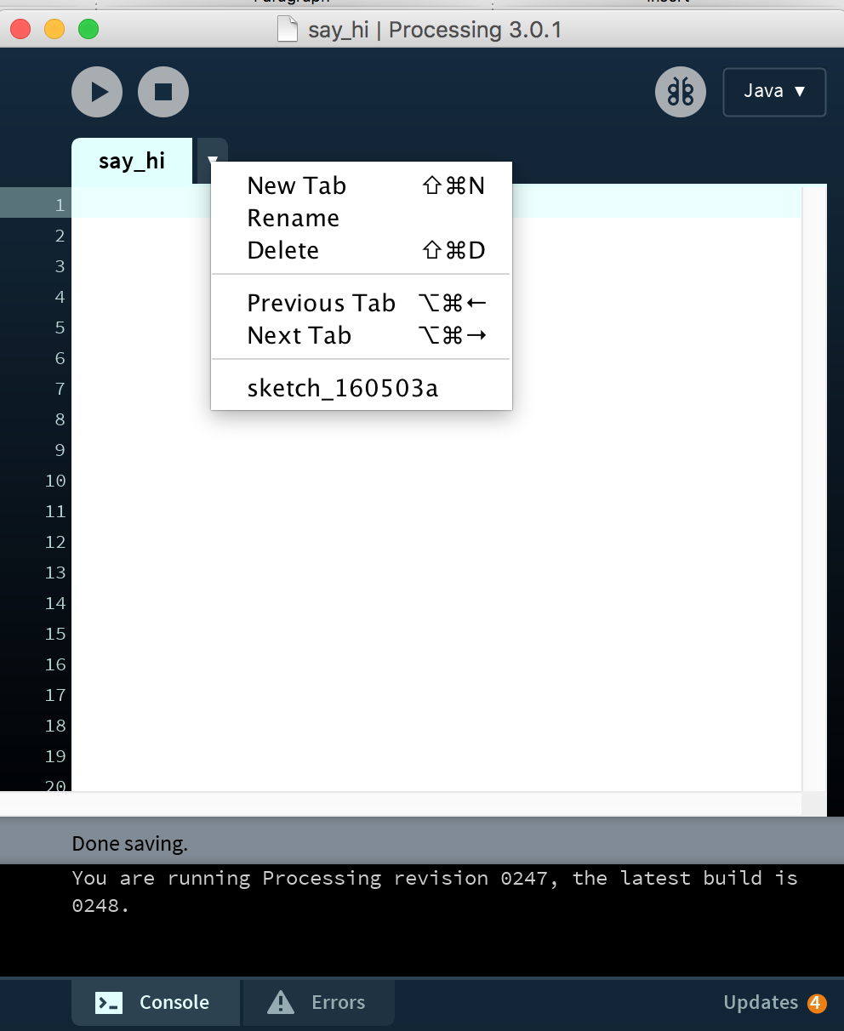
USING TABS
Your Processing sketch starts with a single primary tab, but you can easily create new tabs to help organize your code as your sketch grows in complexity.
It is pretty typical to put classes into their own tab.
Processing可以tab管理代码，而将class文件放到一个新的tab中是很常见的做法

Slide 28

ENCAPSULATION｜封装
Object oriented programming provides encapsulation (bundling and protection) of data.
Encapsulation can be used to restrict access to and to keep fields and methods safe from the general program and from accidental misuse.
The public and private keywords can be used to allow and disallow access.
This keyword is used to disallow other classes access to the fields and methods within a class. The private keyword is used before a field or method that you want to be available only within the class. In Processing, all fields and methods are public unless otherwise specified by the private keyword.

Slide 29
ARRAYLISTS

Slide 30
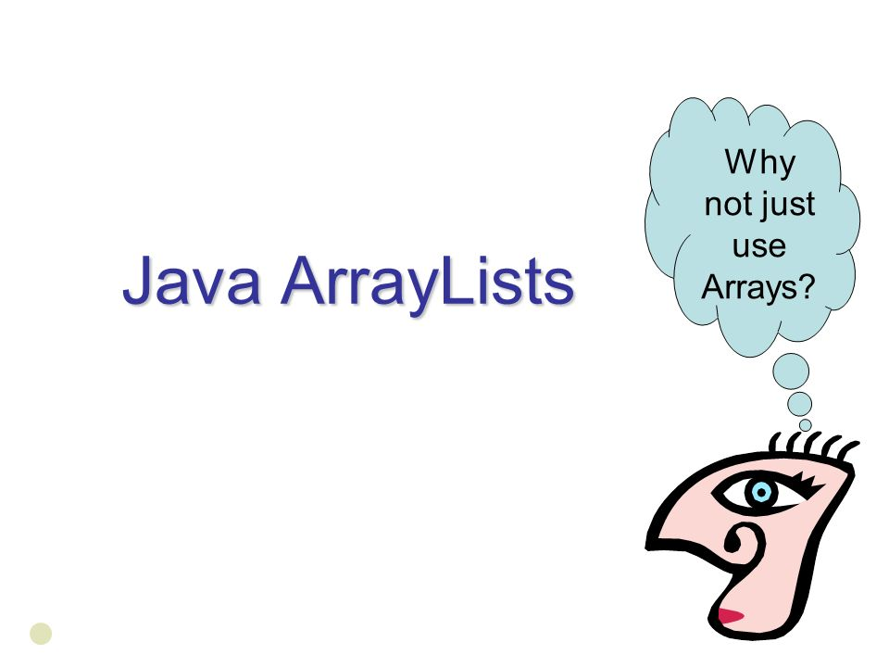
ARRAYLISTS
Arraylists are a dynamically resizable variable type designed to store multiple objects.
Arraylists are based on Java Lists, and are more convenient than arrays for storing objects, because of their dynamically resizable nature.
Arraylists have a size() method rather than a length field, but it serves the same purpose.
Arraylist是个动态可改变尺寸的变量类型，某些情况下比arraylist方便，因为它的动态尺寸。对应于array的length（），arraylist有size（）function

Slide 31
ARRAYLIST USAGE EXAMPLE｜示例
ArrayList<Dog>
puppies;
puppies = new
ArrayList<Dog>();
puppies.add(new Dog(10, 10,
50));
for (int i = puppies.size()-1; Dog puppy = puppies.get(i); puppy.bark();
i >= 0; i--) {
}
puppies.remove(0);

